Slide 1

Lecture 10
Math Foundations Team

Slide 2
Introduction
Last class we studied Gradient Descent Algorithm and some of the issues in fixing the learning parameter.
In this lecture we are going to see some minutiae of gradient descent that we need to address.
Machine learning algorithms depend heavily on the correctness of the gradient since if the gradient is computed erroneously, the algorithms might fail to find the local or global optimum.
We will also just start the topic constrained optimization

Slide 4
Optimization of Additionally separable sum
We can write the total objective function as
n
L(θ) = L (θ)
Σ
i
i =1
This type of linear separability is useful since it enables the use of techniques like stochastic gradient descent and
mini-batch stochastic gradient descent.
The idea here is that we can replace the gradient of the entire objective function with a sampled approximation.

Slide 5
Overfitting in machine learning
In traditional optimization, we focus on updating parameters so that the objective function is minimized as much as possible.
In machine learning, minimization of the objective function is performed over training data but the model is applied on test data which is unseen.
We need to avoid the problem of overfitting the training data.

Slide 6

Overfitting in machine learning
Suppose we have 4-dimensional data and one dependent variable, ie output that is a function of the four inputs.
Let the input parameters be x₁, x₂, x₃, x₄ and the output be y .
We seek the learning parameters w₁, w₂, w₃, w₄, w₅ such that our prediction expression yˆ = w₁x₁ + w₂x₂ + w₃x₃ + w₄x₄ + w₅ gives a good prediction.
►
We would like to minimize the squared error
Σ
n i =1
y − yˆ ²
2

Slide 7
Example of overfitting
Consider the following data on 4 variables x₁, x₂, x₃, x₄ and associated output variable y .
Let us say that this is a sample of real-life data where the output y ≈ x₁.
x₁ | x₂ | x₃ | x₄ | y
61 | 2 | 3 | 0.1 | 49
40 | 0 | 4 | 0.5 | 40
68 | 0 | 10 | 1.0 | 70
For Example we can think x₁ as weight and y as height of a person and x₂, x₃ and x₄ are features that are not much relevant to height.

Slide 8
Example of overfitting
Minimizing squared error, we notice that one good solution is
w₁ = 1, w₂ = w₃ = w₄ = 0, w₅ = 0.
This solution does not give zero squared error with respect to the actual observations but gives an error close to zero.
The solution w₁ = 1, w₂ = w₃ = w₄ = 0, w₅ = 0 is a very good one since it captures the real-life relationship between the output variable y and x₁.

Slide 9
Example of overfitting
Consider w₁ = 0, w₂ = 7, w₃ = 5, w₄ = 0, w₅ = 20. This solution gives zero training error.
It is a very poor solution since there is no dependence of the output variable y on x₁ while we know that there is actually a strong dependence between y and x₁.
Therefore it will incur a high error on test-data.
This example illustrates the idea that minimizing the loss function to the greatest extent may not be a good thing since the model may then perform poorly on real-life data.

Slide 11
Feature processing
Taking small steps in w₂ and large steps in w₁ will make us go steadily towards the optimal value for w₂ but oscillate with respect to the optimal value of w₁, overshooting the target each time.
This makes convergence very slow.
It is therefore helpful to have features with similar variance.

Slide 12
Feature processing
Two techniques used for achieving similar variance are mean-centering and feature normalization.
In case of mean-centering a vector of column-wise means is subtracted from each data point.
In case of feature normalization, each feature value is divided by its standard deviation.
In case of min-max normalization we scale the jth feature of
the i th data point as follows: x_{ij} = ^{xij −minj} .
max_{j} − min_{j}

Slide 13


Example: Feature Processing using Mean centering and Normalization
Person ID | Age x_{ij} | No of years of college Education x_{2j} | X_{1j} –Mean = y_{1j} | X_{2j} – Mean = y_{2j} | Y_{1jj}/std dev | Y_{2jj}/std dev
Wealth in thousands of Rupees
1 | 22 | 4 | -12.375 | -1 | -1.2466 | -0.95233 | 45
2 | 25 | 5 | -9.375 | 0 | -0.94439 | -0.72146 | 60
3 | 30 | 6 | -4.375 | 1 | -0.44072 | -0.33668 | 80
4 | 28 | 4 | -6.375 | -1 | -0.64219 | -0.49059 | 55
5 | 35 | 7 | 0.625 | 2 | 0.06296 | 0.048097 | 110
6 | 40 | 5 | 5.625 | 0 | 0.566636 | 0.432877 | 100
7 | 45 | 6 | 10.625 | 1 | 1.070313 | 0.817657 | 120
8 | 50 | 3 | 15.625 | -2 | 1.57399 | 1.202437 | 90
Avg | 34.375 | 5
Std Dev |  |  | 9.927415 | 1.309307

Slide 14
Feature Processing
From the table in the previous slide one can observe that the mean centering and normalization make the features to have similar variances.
Please try to form a table for Feature processing using Min – Max normalization

Slide 15
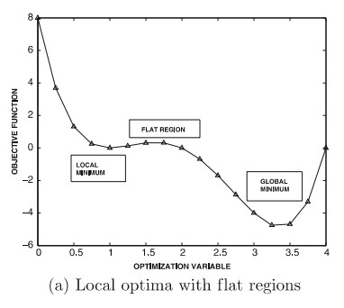
Challenges in Gradient-Based Optimization
Flat regions and local optima
Different levels of curvature in different directions

Slide 18
Local optima and flat regions
Consider F (x₁, x₂, . . . x_{d} ) = A₁(x₁) + A₂(x₂) + . . . + A_{n}(x_{n}).
Let A_{i} (x_{i} ) have k_{i} local minima.
Setting ^{∂F} = 0 ∀i , we note that any point (x₁∗, x₂∗, . . . , x_{d}∗),
∂x_{i}
where x_{i}∗ is a local minima of the function A_{i} (x_{i} ), is a solution
to ^{∂F} = 0.
∂x_{i}

Slide 19
Local optima and flat regions
►
∂F
′ ∗
∗
This is because |
∗ ∗
∗
= A (x ) = 0 since x is a local
∂x_{i}
(x ,x ,...x )
i i
i
minimum of A_{i} (x_{i} ).
1 2 d
►
There are
Π
i =d i =1
k local minima for the function
i
F (x₁, x₂, . . . , x_{d} ), which is very large number of points.
Gradient descent could be stuck at any one of these points which might be far from the global optimum.

Slide 20
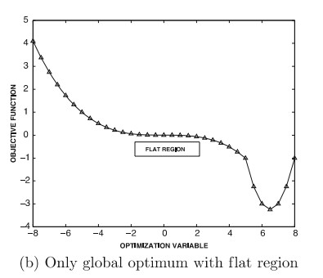
Local optima and flat regions
Another problem to contend with is the presence of flat regions where the gradient is close to zero.

Slide 21
Local optima and flat regions
Flat regions are problematic because the speed of descent depends on the magnitude of the gradient, given a fixed learning rate.
The optimization process will take a long time to cross a flat region of space which will make convergence slow.

Slide 22
Different levels of curvature
In multi-dimensional settings, the components of the gradient with respect to different parameters can vary widely. This will cause convergence problems since there is oscillation in the update step with respect to some components and a steady movement with respect to other components.
Consider the simplest possible case of a bowl-like convex, quadratic objective function with a single global minimum - L = x ² + y ² represents a perfectly circular bowl, and another objective function L = x ² + 4y ².
We shall show contour plots of both functions and how gradient descent performs on finding the minimum of the two functions.

Slide 23
Different levels of curvature
What is the qualitative difference between L = x ² + y ² and
L = x ² + 4y ². Intuitively one looks symmetric in x and y , and the other is not.
The second loss function is more sensitive to changes in y as compared to x - it looks like an elliptical bowl. The specific sensitivity depends on the position of x, y .
Looking at the second-order derivatives we can see that for the second function ^{∂2L} and ^{∂2L} are very different.
_{∂x} 2 _{∂y} 2

Slide 24
Different levels of curvature
The second-order derivative measures the rate of change of the gradient - a high second-order derivative means high curvature.
From the point of view of gradient descent we want moderate curvature in all dimensions as it would mean that the gradient does not change too much in some dimensions compared to others.
We can then make gradient-descent steps of large sizes.

Slide 25
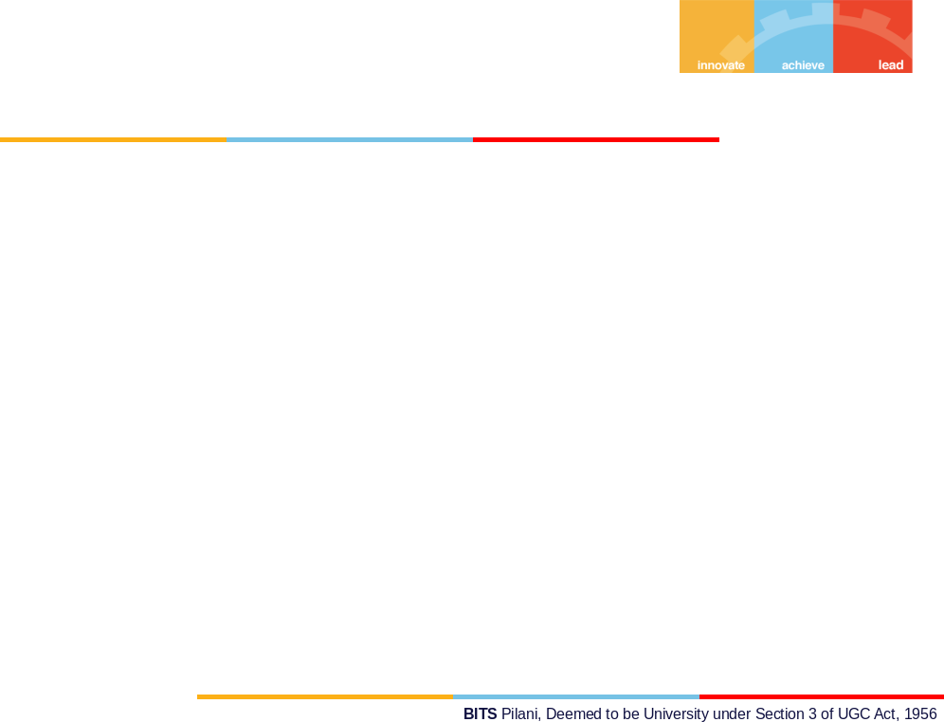
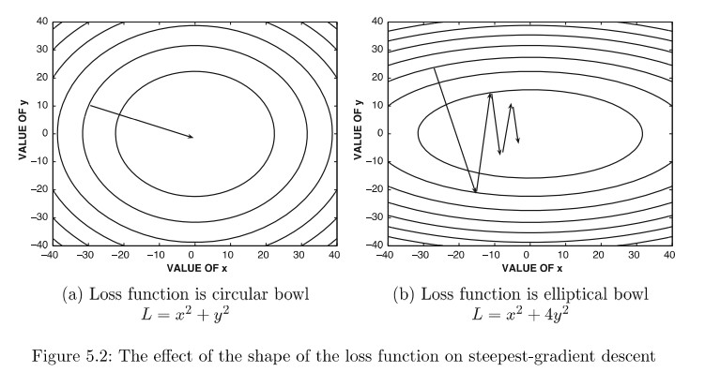
Different levels of curvature

Slide 26
Different levels of curvature
In case of the perfect bowl, a sufficiently large step-size from any point can take us directly to the optimum of the function in one-step, since the gradient at any point points towards the optimum of the function.
This is not true for the elliptical bowl, the gradient at any point does not point to the optimum of the function.

Slide 27
Contour plots
Note that the gradient at any point is orthogonal to the contour line at that point.
This because the dot product of the gradient ∇F and a small displacement δx along the contour line gives the change in the value of the function along the displacement x.
Since the function remains constant along the contour line,
∇F. x = 0.

Slide 28
Differential curvature
A closer look at the contour plot for the elliptical bowl case shows that in the y -direction, we see oscillatory movement as in each step we correct the mistake of overshooting made in the previous step. The gradient component along the
y -direction is more than the component along the x -direction.
Along the x -direction, we make small movements towards the optimum x -value. Overall, after many training steps we find that we have made little progress to the optimum.
It needs to be kept in mind that the path of steepest descent in most objective functions is only an instantaneous direction of best improvement, and is not the correct direction of descent in the longer term.

Slide 29
Revisiting feature normalization
We show how to address in some measure the differential curvature problem by feature normalization.
Consider the following toy dataset, where the two input attributes are x₁ and x₂ , and the output attribute is y .
We intend to find a relationship of the form y = w₁x₁ + w₂x₂ from the data. The coefficients w₁ and w₂ are found using gradient descent on the loss function computed from the data.
x₁ | x₂ | y
0.1 | 25 | 7
0.8 | 10 | 1
0.4 | 10 | 4

Slide 30
Revisiting feature normalization
Loss function:
J(w) = (0.1w₁+25w₂−7)²+(0.8w₁+10w₂−1)²+(0.4w₁+10w₂−4)²
Objective function is much more sensitive to w₂ than w₁
One way to get around this issue is to standardize each column to zero mean and unit variance
The coefficients for w₁ and w₂ will become much more similar, and differential curvature will be reduced.

Slide 31
Constrained Optimization
Optimization problems are of 2 types
Unconstrained Optimization
Constrained Optimization
We discussed algorithms to solve unconstrained optimization
How do we find the solution to an optimization problem with constraints?
Example of a constrained optimization problem
maximize f (x, y ) = x ²y
subject to g (x, y ) : x ² + y ² = 1

Slide 32
Constrained Optimization : Lagrange Multiplier Method
Constrained maximization (minimization) problem is rewritten as a Lagrange function whose optimal point is a saddle point,
i.e. a global maximum (minimum)
Lagrange function use Lagrange multipliers as a strategy for finding the local maxima and minima of a function subject to constraints
Maximum of f (x, y ) under constraint g (x, y ) is obtained when their gradients point to same direction
Introduce a Lagrange multiplier λ for the equality constraint Mathematically, ∇f (x, y ) = λ∇g (x, y )
The motivation for Lagrange Multipliers is given in the following slide.

Slide 33
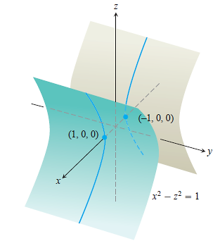
Lagrange Multipliers (Motivation)
Consider the following optimization Problem: Find the points closest to the origin that lies on the hyperbolic cylinder x² – z² = 1.

Slide 34
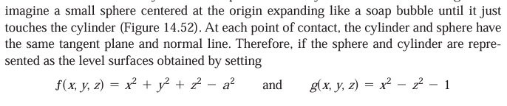
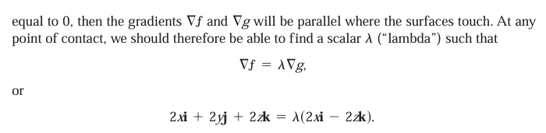
Motivation for Lagrange Multipliers

Slide 35
Lagrange Multipliers (Motivation)
Do you observe that at the extreme points the sphere and the hyperbolic cylinder have the common tangents?
Srprisingly this statement is true in general for any two surfaces f(x,y,z)(objective function)=0 ( and g(x,y,z)=0 onstraint.
This is stated as orthogonal gradient theorem.

Slide 36
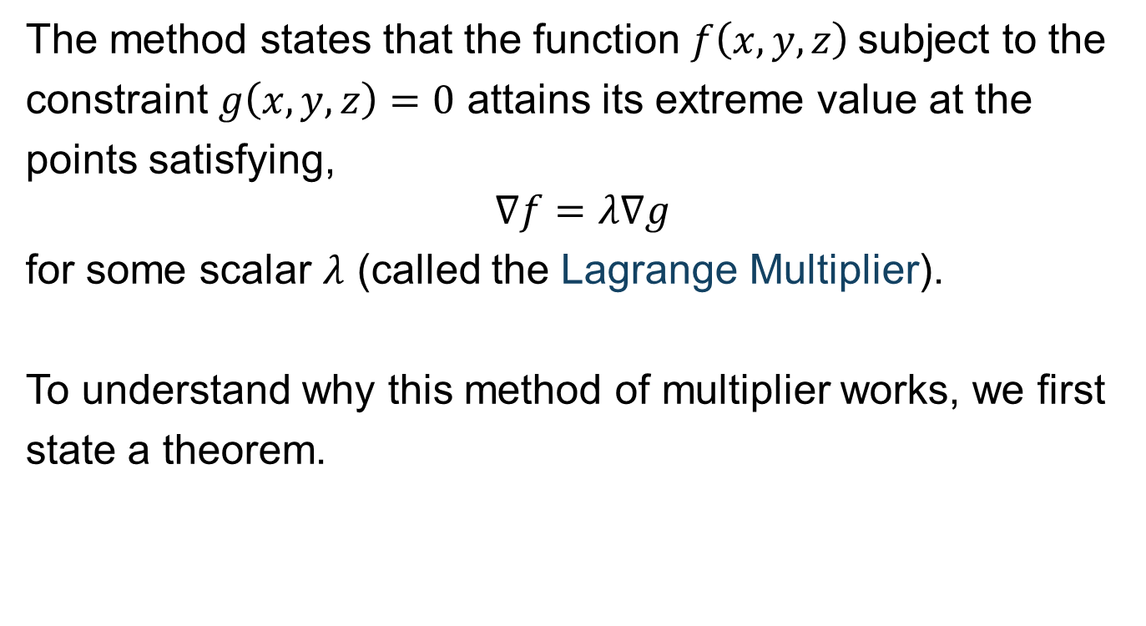
Lagrange Multipliers
The method states that the function $f\left(x,y,z\right)$subject to the
constraint $g\left(x,y,z\right)=0$ attains its extreme value at the
points satisfying, $$∇f=λ∇g$$
for some scalar $λ$ (called the Lagrange Multiplier).
To understand why this method of multiplier works, we first
state a theorem.

Slide 37
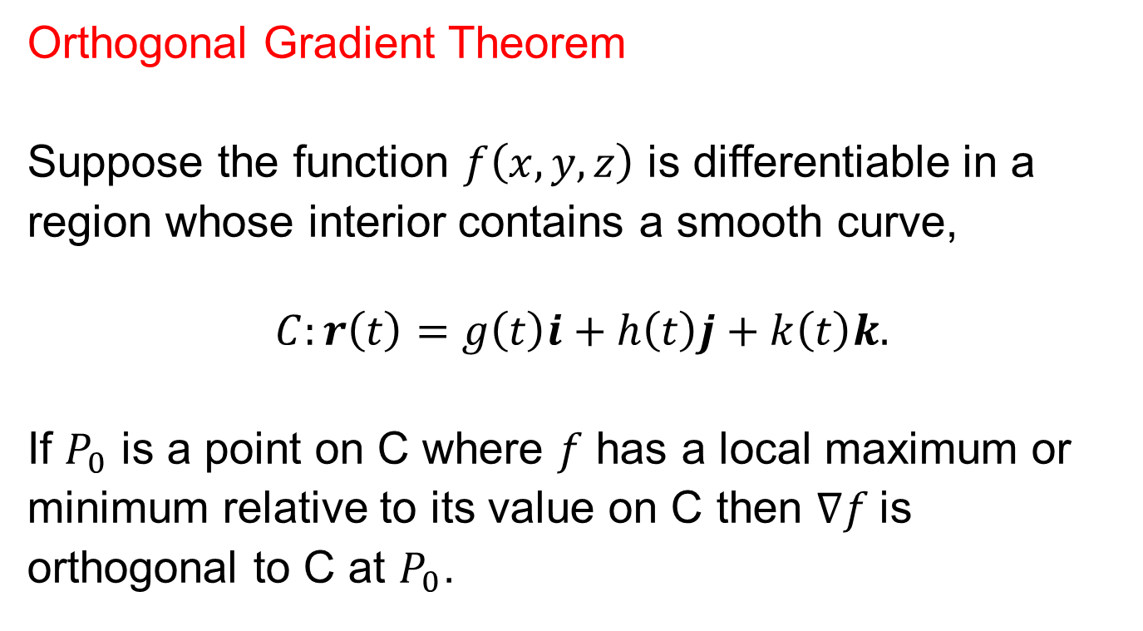
Theorem
Orthogonal Gradient Theorem
Suppose the function $f\left(x,y,z\right)$ is differentiable in a
region whose interior contains a smooth curve,
$$C:r\left(t\right)=g\left(t\right)i+h\left(t\right)j+k\left(t\right)k.$$
If $P_{0}$ is a point on C where $f$ has a local maximum or
minimum relative to its value on C then $∇f$is
orthogonal to C at $P_{0}$.

Slide 38
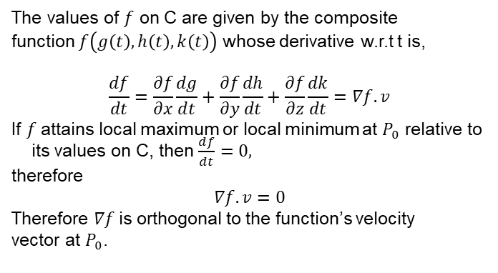
Proof
The values of $f$ on C are given by the composite
function $f\left(g\left(t\right),h\left(t\right),k\left(t\right)\right)$ whose derivative w.r.t t is,
$$\frac{df}{dt}=\frac{∂f}{∂x}\frac{dg}{dt}+\frac{∂f}{∂y}\frac{dh}{dt}+\frac{∂f}{∂z}\frac{dk}{dt}=∇f.v$$
If $f$attains local maximum or local minimum at $P_{0}$ relative to its values on C, then $\frac{df}{dt}=0,$
therefore
$$∇f.v=0$$
Therefore $∇f$is orthogonal to the function’s velocity
vector at $P_{0}$.

Slide 39
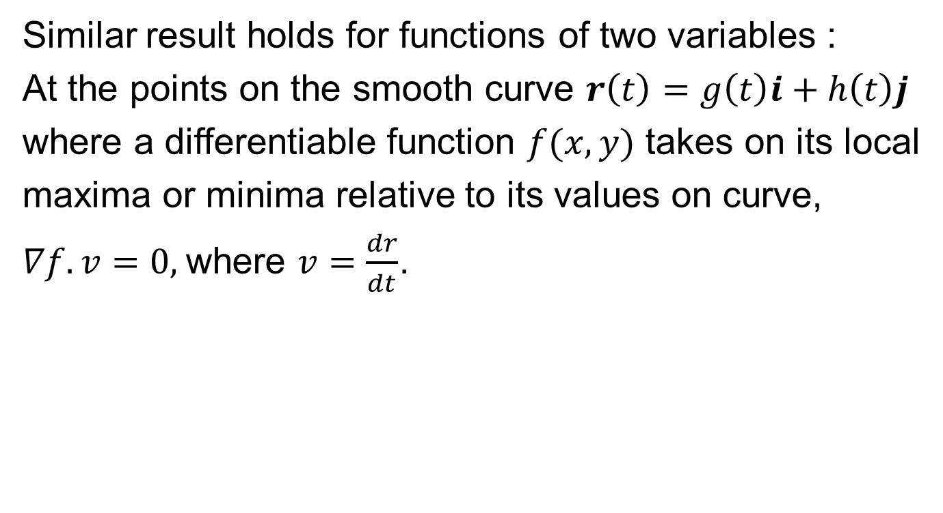
Corollary
Similar result holds for functions of two variables :
At the points on the smooth curve $r\left(t\right)=g\left(t\right)i+h\left(t\right)j$
where a differentiable function $f(x,y)$ takes on its local
maxima or minima relative to its values on curve,
$∇f.v=0,$where $v=\frac{dr}{dt}$.

Slide 40
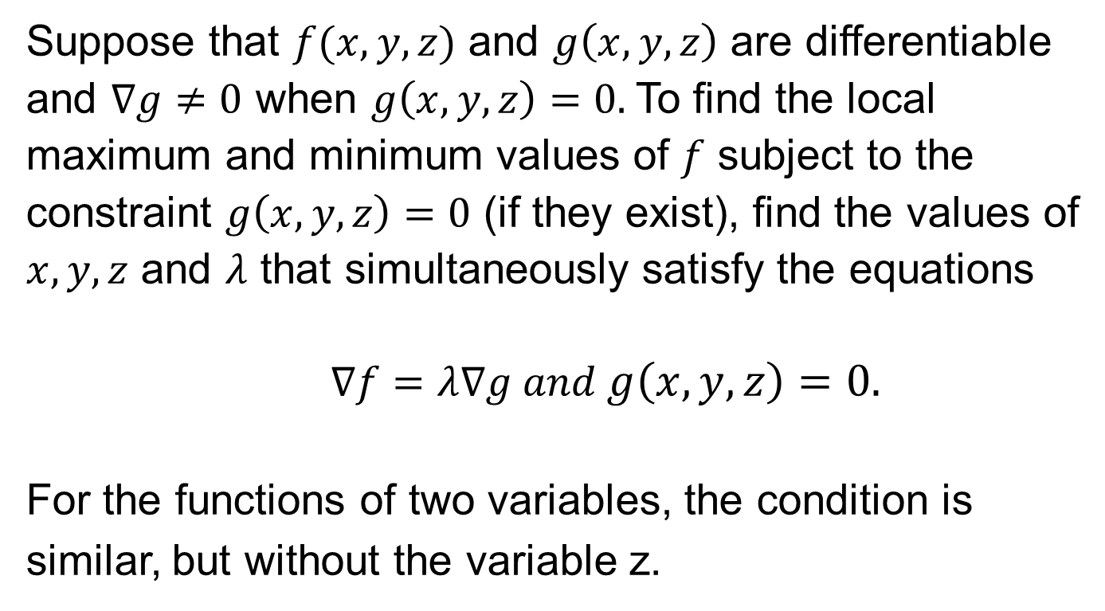
Method of Lagrange Multipliers
Suppose that $f(x,y,z)$ and $g\left(x,y,z\right)$ are differentiable
and $∇g≠0$ when $g\left(x,y,z\right)=0.$To find the local
maximum and minimum values of $f$ subject to the
constraint $g\left(x,y,z\right)=0$ (if they exist), find the values of
$x,y,z$ and $λ$ that simultaneously satisfy the equations
$$∇f=λ∇g and g\left(x,y,z\right)=0.$$
For the functions of two variables, the condition is
similar, but without the variable z.

Slide 41
Why does this Method work?
Suppose that f(x,y,z) and g(x,y,z) are differentiable functions and P₀ is a point on the surface g(x,y,z) = 0 at which f(x,y,z) has local maximum or local minimum relative to other values on the surface g(x,y,z) = 0.
Then f takes on local maximum or local minimum at P₀ relative to every differentiable curve through P₀ that lies on the surface g(x,y,z) = 0.
By the orthogonal gradient theorem ∇f is orthogonal to every differentiable curve through Po that lies on the g(x,y,z)= 0. Therefore ∇f is orthogonal to the tangent plane to the surface g(x,y,z) = 0 at P₀.
But always ∇g is orthogonal to the tangent plane level surface g(x,y,z) = 0 at P₀. Therefore ∇f and ∇g are parallel. ∇f = λ∇g at P₀.

Slide 42
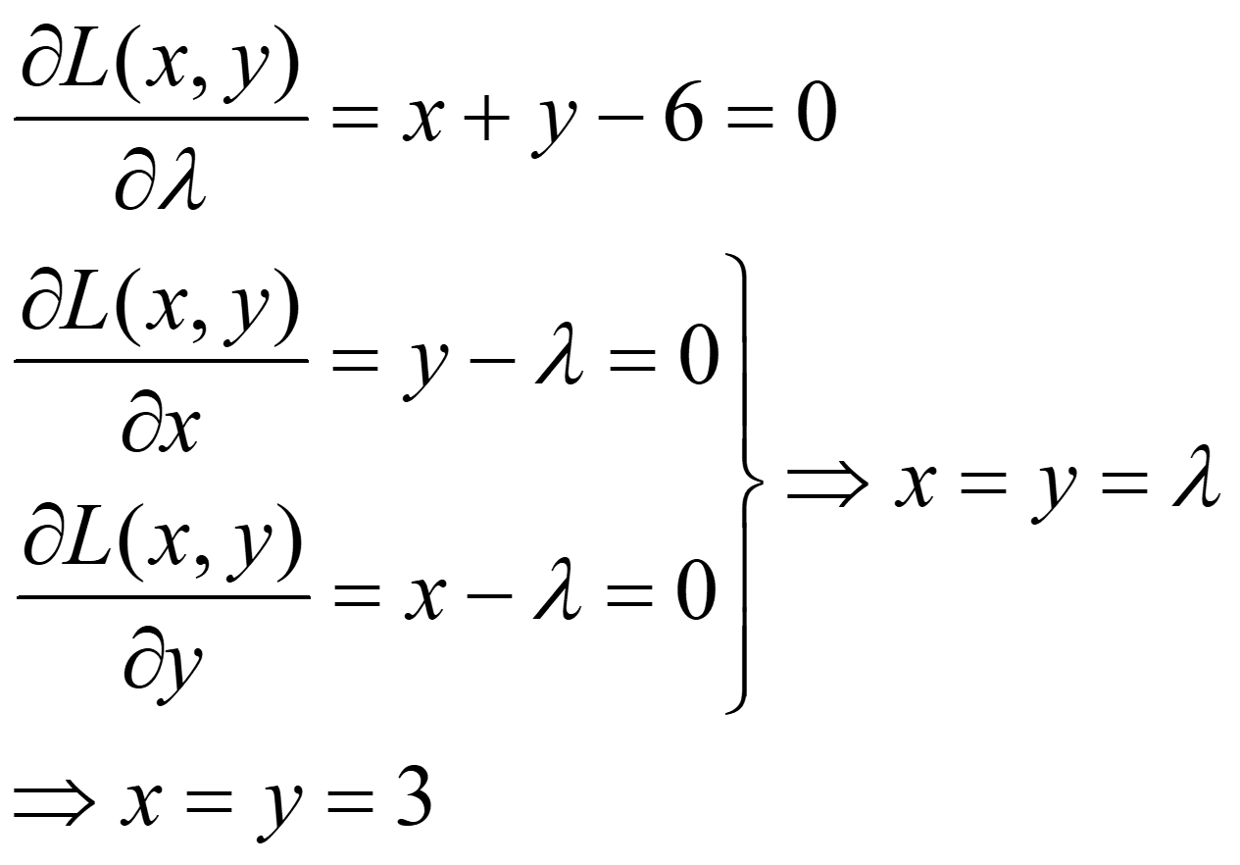
Constrained Optimization : Lagrange Multiplier Method
Consider the following optimization problem
maximize xy
subject to x + y = 6
The Lagrangian is L(x, y ) = xy − λ(x + y − 6)
x and y values remain same even if you take +λ or −λ for equality constraint

